Slide 1


Pakistan International School Riyadh
Coding On
Programmer’s Day
September 12th 2024
Project Name: Brain Games
Developed By: Abdurrahman Jawad & Yahya A.M. Khan
Class: XII - C

Slide 2


About Programmer’s Day
Programmer’s Day is a professional holiday celebrated globally to honour programmers and their contributions to technology. It falls on the 256th day of the year, chosen because it represents the number of distinct values in an 8-bit byte. The holiday originated in Russia and was officially established in 2009. So, next time you encounter a bug or write code, take a moment to appreciate the programmers who shape our digital world! Russian programmers Michael Cherviakov and Valentin Balt chose the day in 2002 because the 256th day of the year. The day honours programmers and innovators who make our lives easier. September 13th is the 256th day of the year.

Slide 3
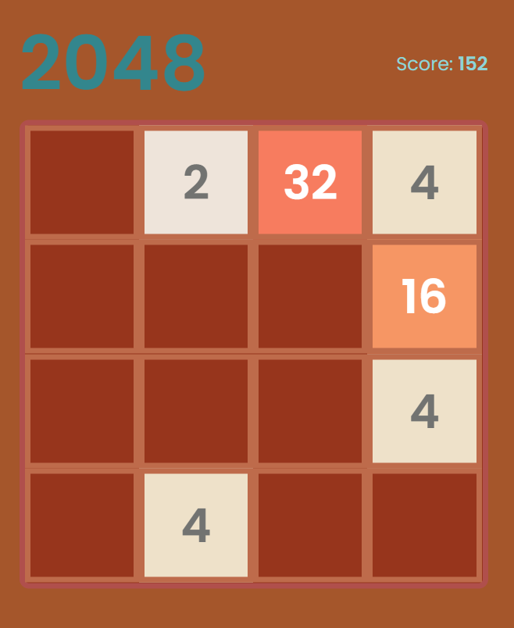
Project Specification
About:
Brain Games is a free website that helps you improve your Intelligence and problem solving techniques with an easy-to-use interface. You are to give answers within a limited period of time.
Tools Used:
Programming Language: HTML, CSS, Java-Script
IDE Software: Visual Studio Code
Application Type: Quizzical

Slide 4
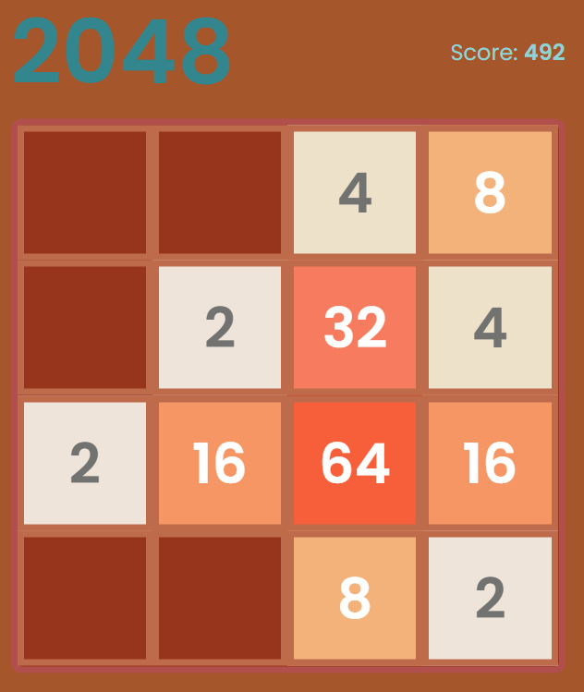
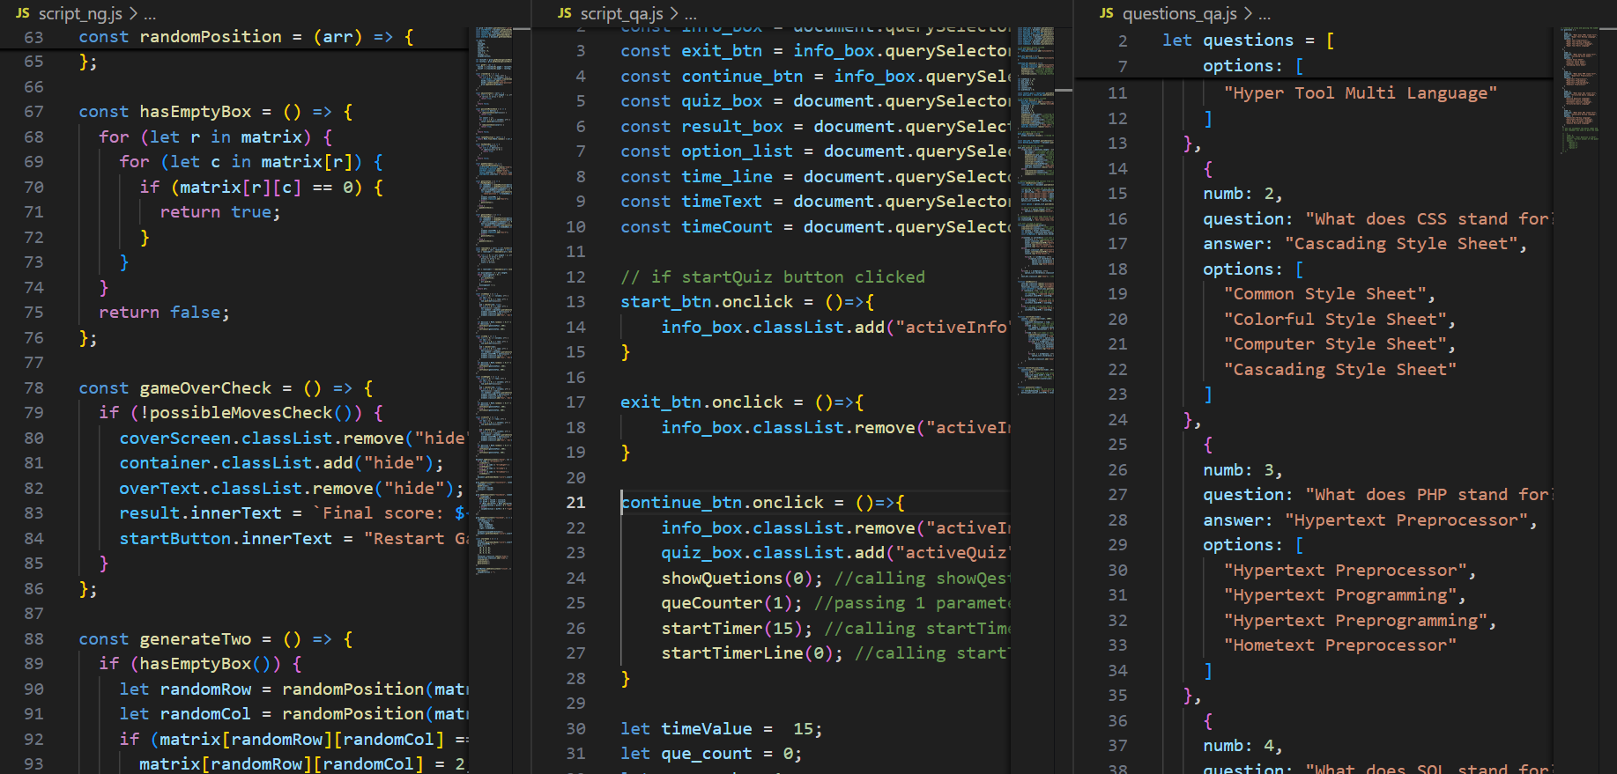
Project Features
IQ Trainer
Math Puzzles
Critical Thinking
Computer Related Quizzes
Problem Thinking

Slide 5
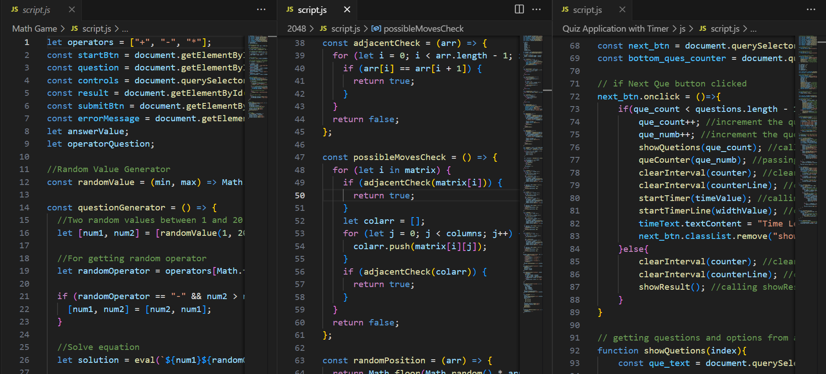
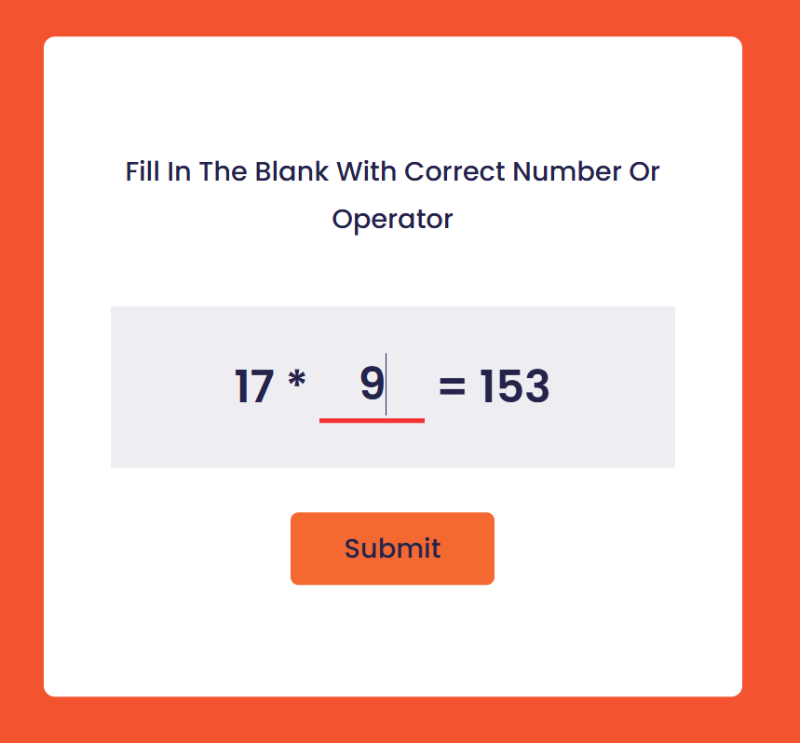
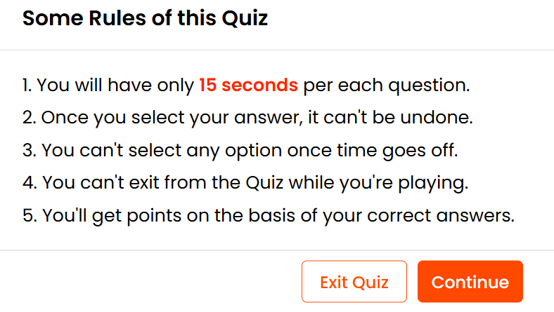
Screenshots

Slide 6
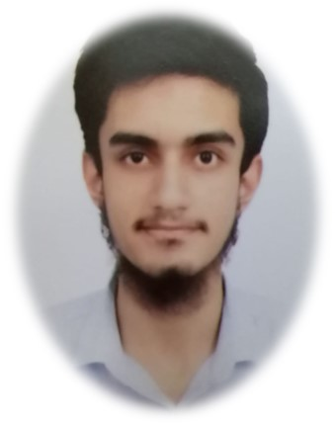
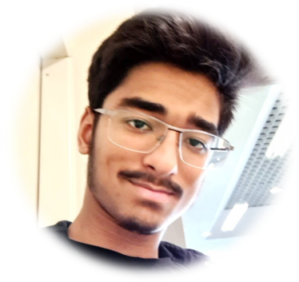
Team Members
Abdurrahman Jawad
Yahya A.M. Khan
Project Coding Time Spent: 36 Hours

Slide 7
Organized by:
Computer Department
High School Boys, PISR
Supporting Teachers:
Muhammad Nasim
Inam Cheema
Faisal Anis

Slide 8
Thank You

